Slide 1
Intel Virtual Storage Manager 0.5 for Ceph In-Depth Training
Tom Barnes Intel Corporation
July 2014
Note: All information, screenshots, and examples are based on VSM 0.5.1

Slide 2
Prerequisites (Not covered in this presentation)
Ceph Concepts
OSD, OSD State
Monitor, Monitor State
Placement Groups, Placement Group state, Placement group count
Replication factor
MDS
Rebalance
General Ceph cluster troubleshooting
OpenStack Concepts
Nova
Cinder
Multi-backend
Volume creation
Swift

Slide 3
Agenda
Part 1: VSM Concepts
Part 2: VSM Operations
Part 3: Troubleshooting Examples
Note: All information, screenshots, and examples are based on VSM 0.5.1

Slide 4
Part 1: VSM Concepts

Slide 5
Part 1: VSM Concepts
VSM
What it is
What it does
Cluster
VSM Controller & Agent
Ceph cluster servers
Ceph clients
OpenStack controller(s)
VSM Controller
Cluster manifest
Storage Groups
Network Configuration
VSM Agent
Server discovery & authentication
Server manifest
Roles
Storage Class
Storage device paths
Mixed used SSD
Servers & Storage Devices
Server state
Device state
Replacing servers
Replacing storage devices
Cluster Data Collection
Data sources and update frequency

Slide 6
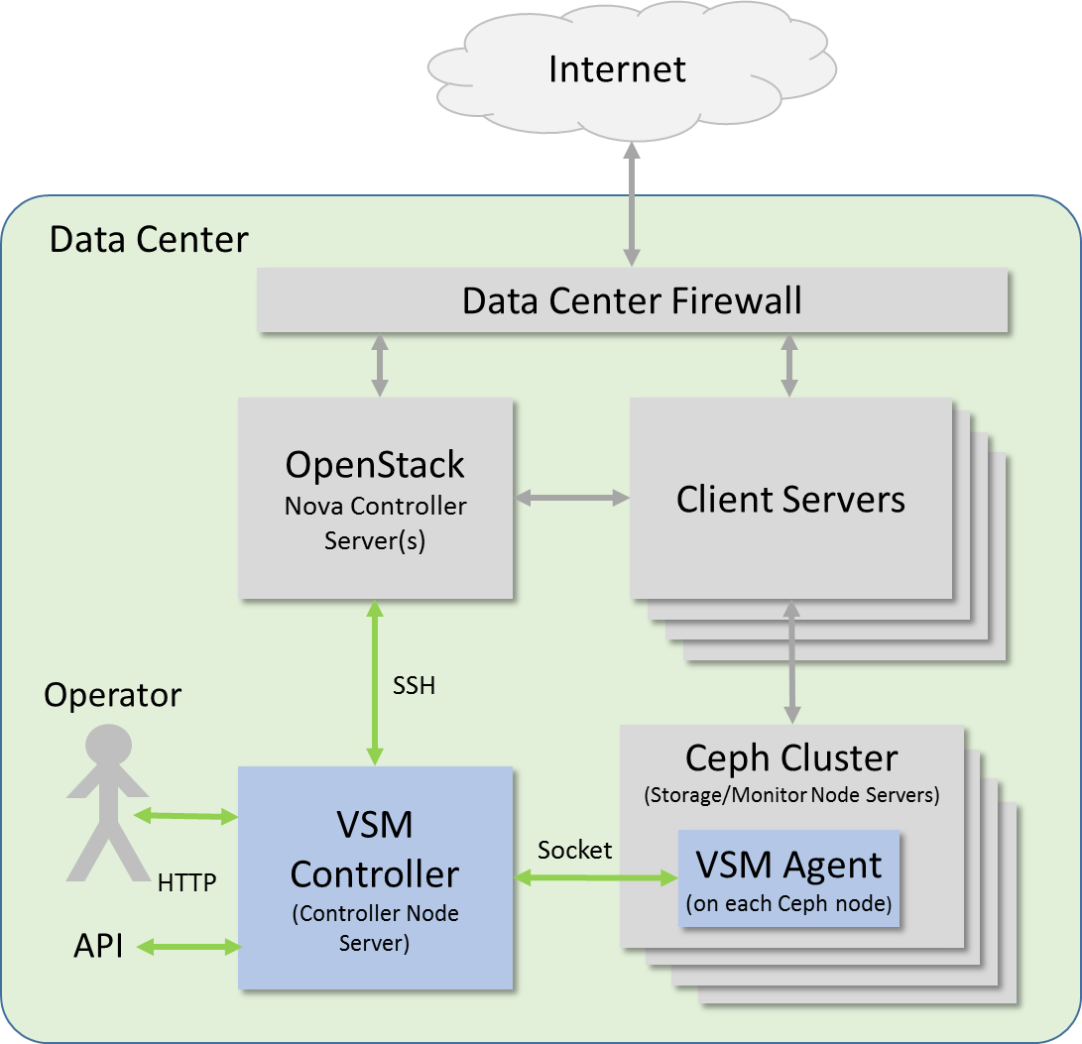
VSM: What it does…
VSM Concepts
Web-based UI
Administrator-friendly interface for cluster management, monitoring, and troubleshooting
Server management
Organizes and manages servers
Organizes and manages disks
Cluster Management
Manages cluster creation
Manages pool creation
Cluster Monitoring
Capacity & Performance
Ceph daemons and data elements
OpenStack Interface
Connecting to OpenStack
Connecting pools to OpenStack
VSM administration
Adding Users
Managing passwords
Management framework = Consistent configuration
Operator-friendly interface for management & monitoring

Slide 7
VSM: What it is…
VSM Concepts
VSM Controller Software
Runs on dedicated server (or server instance)
Connects to Ceph cluster through VSM agent
Connects to OpenStack Nova controller (optional) via SSH
Never touches clients or client data
VSM Agent Software
Runs on every server in the Ceph cluster
Relays server configuration & status information to VSM controller

Slide 8
Typical VSM-Managed Cluster
VSM Concepts
VSM Controller – Dedicated server or server instance
Server Nodes
Are members of VSM-managed Ceph cluster
May host storage, monitor, or both
VSM agent runs on every server in VSM-managed cluster
Servers may contain SSDs for journal or storage or both
Network Configuration
Ceph public subnet – Carries data traffic between clients and Ceph cluster servers
Administration subnet – Carries administrative communications between VSM controller and agents
Also administrative comms between Ceph daemons
Ceph cluster subnet – Carries data traffic between Ceph storage nodes – replication and rebalancing
OpenStack admin (optional)
One or more OpenStack servers managing OpenStack assets (clients, client networking, etcetera)
Independent OpenStack-managed network – not managed by or connected to VSM
Optionally connected to VSM via SSH connection
Allows VSM to “tell” OpenStack about Ceph storage pools
OpenStack-Administered Network
VSM
Controller
OpenStack
Admin
Client
Node
Client
Node
Client
Node
Client
Node
SSH
RADOS
RADOS
RADOS
RADOS
Ceph public - 10GbE
or InfiniBand
Administration GbE
Ceph cluster 10GbE
or InfiniBand
Server Node
Server Node
Server Node
Server Node
Server Node
VSM Agent
VSM Agent
VSM Agent
VSM Agent
VSM Agent
Monitor
Monitor
Monitor
Monitor
OSD
OSD
OSD
OSD
OSD
OSD
OSD
OSD
OSD
OSD
OSD
OSD
SSD
SSD
SSD
SSD

Slide 9
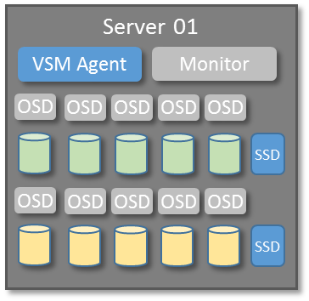
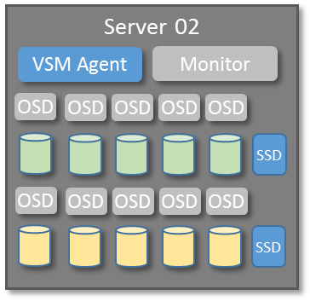
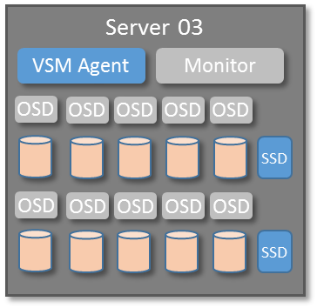

Managing Servers and Disks
VSM Concepts
Servers can host more than one type of drive
Drives with similar performance characteristics are identified by Storage Class. Examples:
7200_RPM_HDD
10K_RPM_HDD
15K_RPM_HDD
Drives with the same Storage Class are grouped together in Storage Groups
Storage Groups are paired with specific Storage Classes. Examples:
Capacity = 7200_RPM_HDD
Performance= 10K_RPM_HDD
High Performance= 15K_RPM_HDD
VSM monitors Storage Group capacity utilization, warns on “near full” and “full”
Storage Classes and Storage Groups are defined in the cluster manifest file
Drives are identified by Storage Class in the server manifest file
7200_RPM_HDD
10K_RPM_HDD
15K_RPM_HDD
“Capacity” = 7200_RPM_HDD “Performance” = 10K_RPM_HDD “High Performance” = 15K_RPM_HDD
Capacity
Performance
High Performance

Slide 10
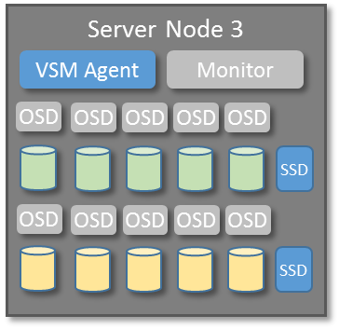



Managing Failure Domains
Zone 2
Zone 1
Zone 3
VSM Concepts
Servers can be grouped into failure domains. In VSM, failure domains are indented by zones.
Zones are placed under each Storage Group
Drives in each zone are placed in their respective storage group
In the example at right, six servers are placed in three different zones. VSM creates three zones under each storage group, and places the drives in their respective storage groups and zones.
Zones are defined in the cluster manifest file
Zone membership is defined in the server manifest file
Capacity
Performance
Zone 1
Zone 2
Zone 2
Zone 1
Zone 2
Zone 2
One Zone with server-level replication
7200_RPM_HDD
(Capacity)
10K_RPM_HDD
(Perfromance)

Slide 11
VSM Controller: Cluster Manifest File
VSM Concepts
[storage_class]
7200_rpm_sata
10krpm_sas
ssd
ssd_cached_7200rpm_sata
ssd_cached_10krpm_sas
[storage_group]
#format: [storage group name] ["user friendly storage group name"] [storage class]
high_performance "High_Performance_SSD" ssd
capacity "Economy_Disk" 7200_rpm_sata
performance "High_Performance_Disk" 10krpm_sas
value_performance "High_Performance_Disk_with_ssd_cached_Acceleration" ssd_cached_10krpm_sas
value_capacity "Capacity_Disk_with_ssd_cached_Acceleration" ssd_cached_7200rpm_sata
[cluster]
cluster_a
[file_system]
xfs
[management_addr]
192.168.123.0/24
[ceph_public_addr]
192.168.124.0/24
[ceph_cluster_addr]
192.168.125.0/24
[storage_group_near_full_threshold]
70
[storage_group_full_threshold]
80
Storage classes defined
Storage groups defined, assigned “friendly” name, and associated with storage class
Cluster name
Data disk file system
Cluster Manifest File
Resides on the VSM controller server.
Tells VSM how to organize storage devices, how the network is configured, and other management details
Network configuration
Storage group near full and full thresholds

Slide 12
VSM Agent: Discovery and Authentication
VSM Concepts
VSM Agent runs on every server managed by VSM
VSM Agent uses the server manifest file to identify and authenticate with the VSM controller, and determine server configuration
Discovery and authentication
To be added to a cluster, the server manifest file must contain the IP address of the VSM controller, and a valid authentication key
Generate a valid authentication key on the VSM controller using the xxxxxxxxx utility
The authentication key is valid for 120 minutes, after which a new key must be generated
When VSM agent first runs, it contacts the VSM controller
It provides the authentication key located in the storage manifest file
Once validated, the VSM agent is always recognized by the VSM controller

Slide 13
VSM Agent: Roles & Storage Configuration
VSM Concepts
Roles
Servers can run ODS daemons (if they have storage devices), Monitor daemons, or both.
Storage Configuration
The storage manifest file identifies all storage devices and associated journal partitions on the server
Storage devices are organized by Storage Class (as defined in Cluster Manifest)
Devices and partitions are specified “by path” to ensure that paths remain constant in the event of a device removal or failure
SSD as journal and data drive
SSDs may be used as journal devices to improve write performance
SSDs are typically partitioned to provide journals for multiple HDDs
Remaining capacity not used for journal partitions may be used as OSD device
VSM relies on the server manifest to identify and classify data devices and associated journals. VSM does not have knowledge of how SSDs have been partitioned.

Slide 14
VSM Agent: Server Manifest
VSM Concepts
[vsm_controller_ip]
#10.239.82.168
[role]
storage
monitor
[auth_key]
token-tenant
[7200_rpm_sata]
#format [sata_device] [journal_device]
%osd-by-path-1% %journal-by-path-1%
%osd-by-path-2% %journal-by-path-2%
%osd-by-path-3% %journal-by-path-3%
%osd-by-path-4% %journal-by-path-4%
[10krpm_sas]
#format [sas_device] [journal_device]
%osd-by-path-5% %journal-by-path-5%
%osd-by-path-6% %journal-by-path-6%
%osd-by-path-7% %journal-by-path-7%
%osd-by-path-7% %journal-by-path-7%
[ssd]
#format [ssd_device] [journal_device]
[ssd_cached_7200rpm_sata]
#format [intel_cache_device] [journal_device]
[ssd_cached_10krpm_sas]
#format [intel_cache_device] [journal_device]
Address of VSM Controller
Server Manifest File
Resides on each server that VSM manages.
Defines how storage is configured on each server
Identifies other roles (Ceph daemons) that should be run on the server
Authenticates servers to VSM controller
Include “storage” if server will host OSD daemons
Include “monitor” if server will host monitor daemons
Authentication key provided by authentication key tool on VSM controller node.
Storage Class 7200_rpm_sata: Specifies path to four 7200 RPM drives and their associated journal drives/partitions
Storage Class 10krpm_sas: Specifies path to four 10K RPM drives and their associated journal drives/partitions
No drives associated with these Storage Class

Slide 15
Part 2: VSM Operations

Slide 16
Part 2: VSM Operations
VSM Operations
Getting Started
Log In
EULA
Create Cluster
Navigation
Dashboard Overview
Managing Capacity
Storage Group Status
Manage Pools
Creating Storage Pools
RBD Status
Monitoring Cluster Health
Dashboard Overview
OSD Status
Monitor Status
PG Status
MDS Status
Managing Servers
Manage Servers
Add & Remove Servers
Add & Remove Monitors
Stop & Start Servers
Managing Storage Devices
Manage Devices
Restart OSDs
Remove OSDs
Restore OSDs
Working with OpenStack
OpenStack Access
Managing Pools
Managing VSM
Manage VSM Users
Manage VSM Configuration

Slide 17
Getting Started

Slide 18
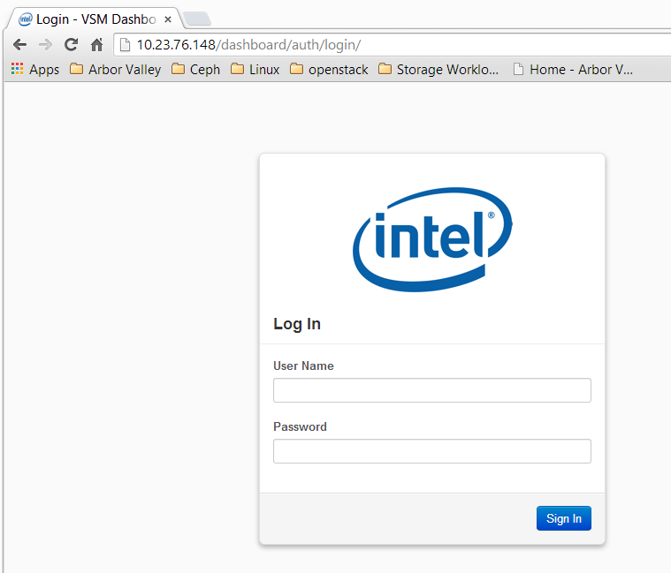
Logging In
Getting Started
User Name
(Default: admin)
First Time Password
Auto-generated on VSM Controller:
#cat /etc/vsmdeploy/deployrc | grep ADMIN >vsm-admin-dashboard.passwd.txt
#cat vsm-admin-dashboard.passwd.txt
Password
(default: See note at right)

Slide 19
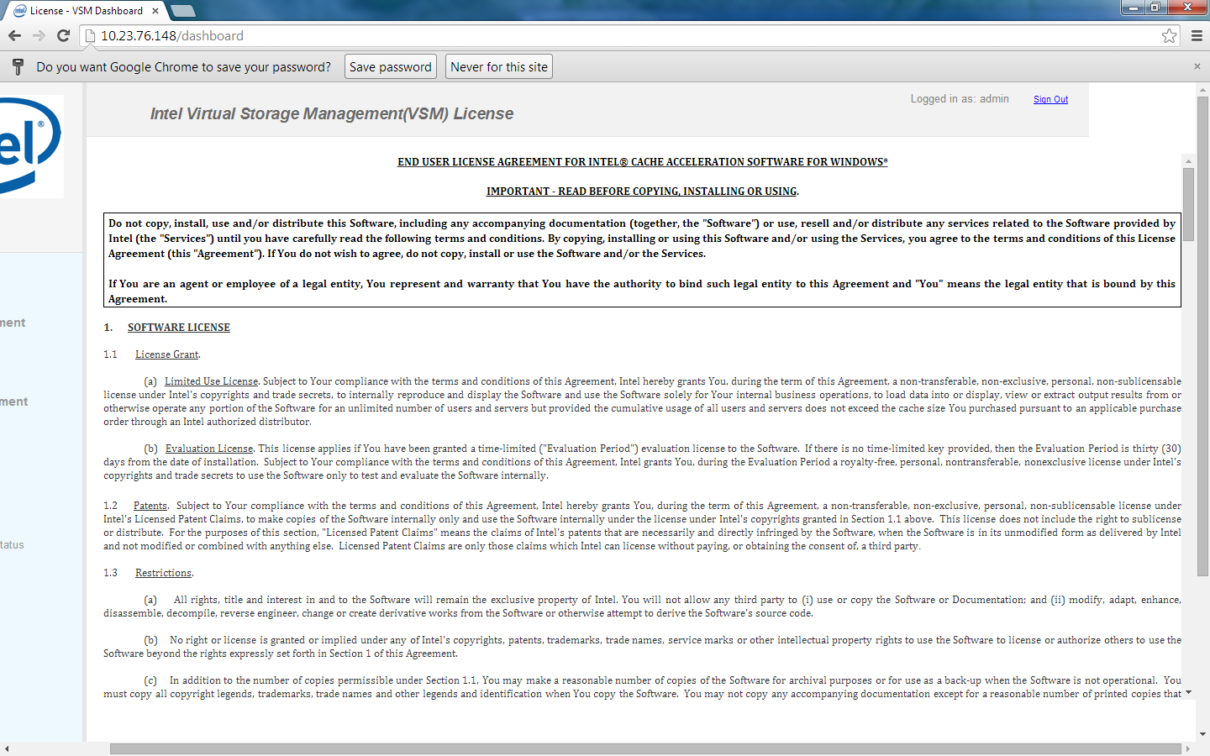
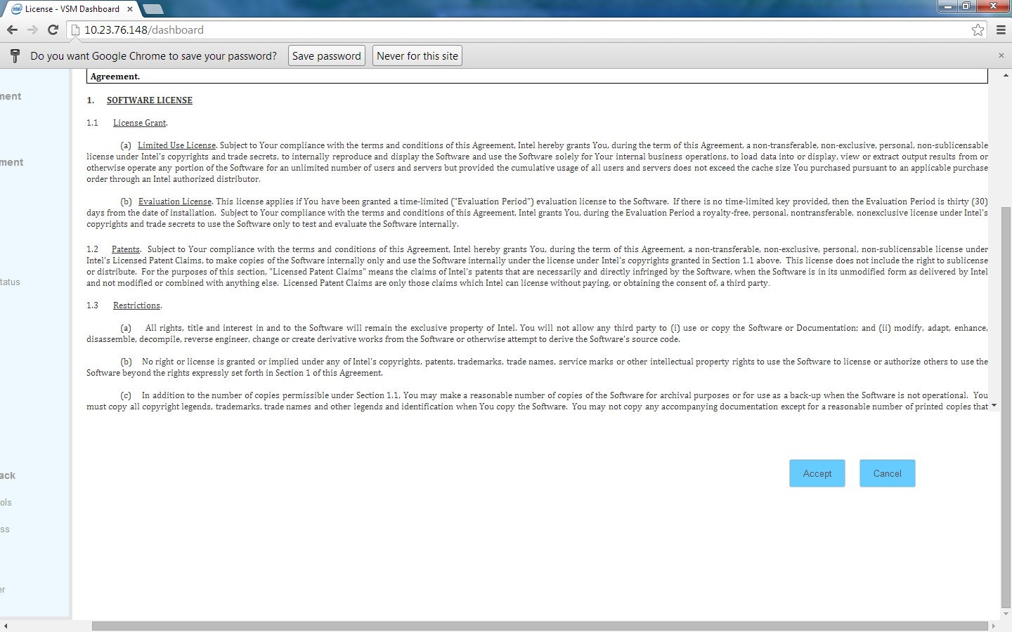
EULA
Getting Started
Accept
Read

Slide 20
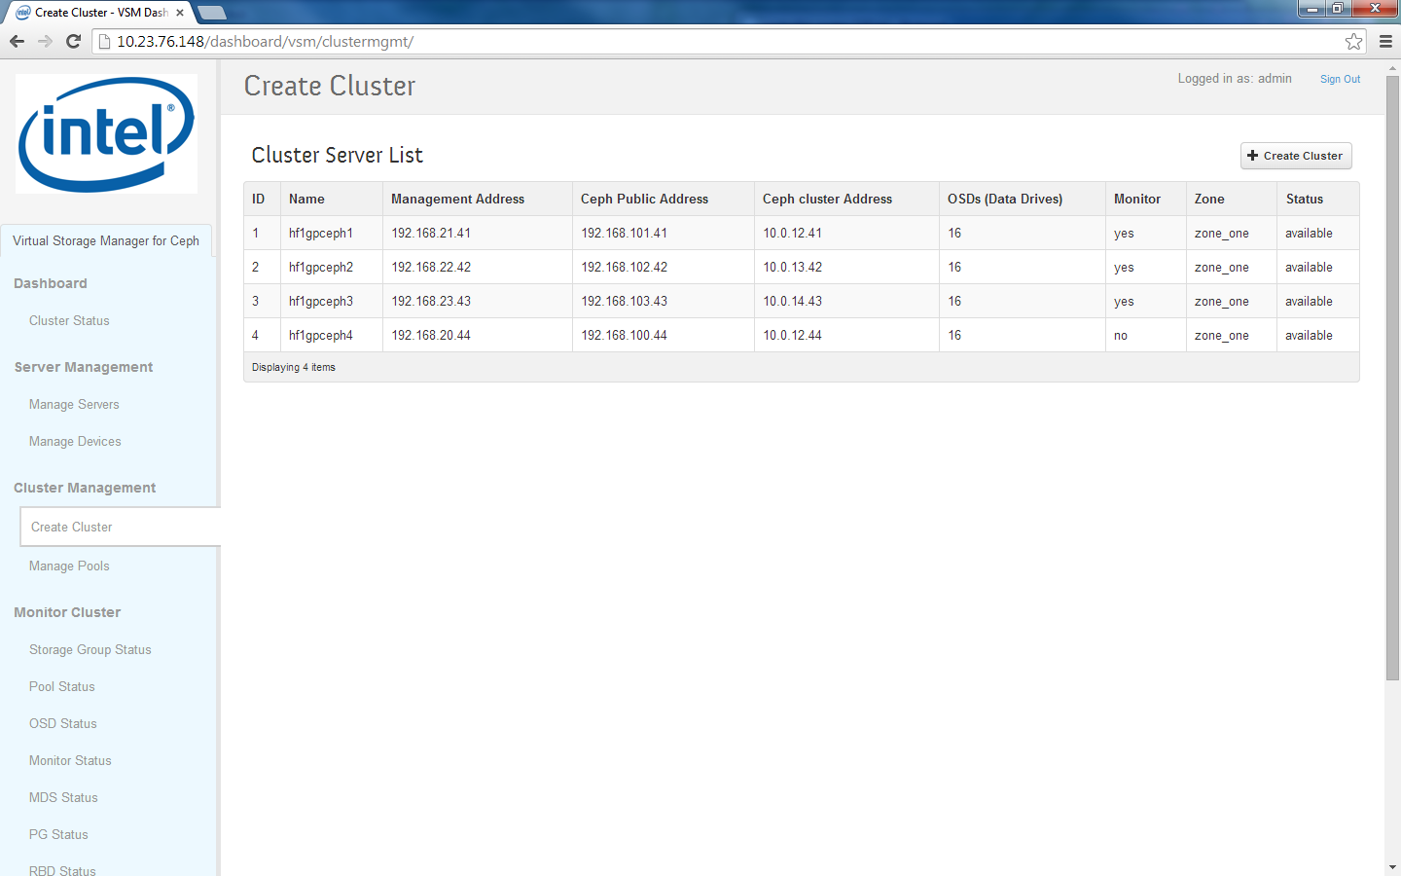
Create Cluster
Getting Started
At least three monitors & odd number of monitors
Servers responsive
All servers present
Correct subnets and IP addresses
Correct number of disks identified
Servers located in correct zone
Create new Ceph cluster
One Zone with server-level replication

Slide 21
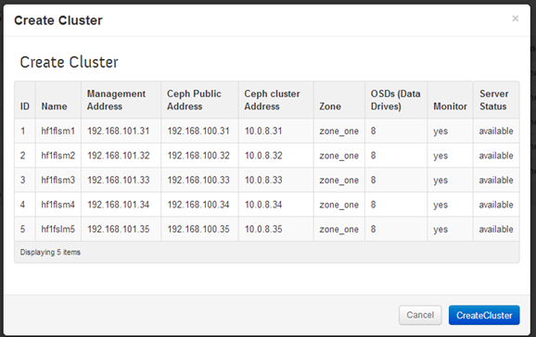
Create Cluster
Getting Started
Step 1
Step 2: Confirm

Slide 22
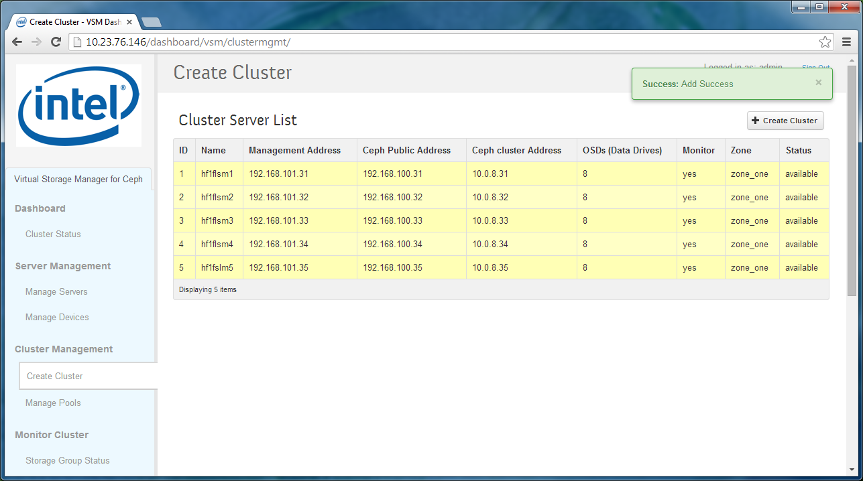
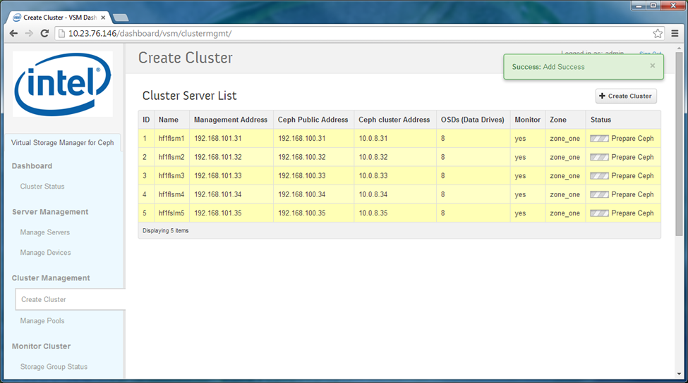




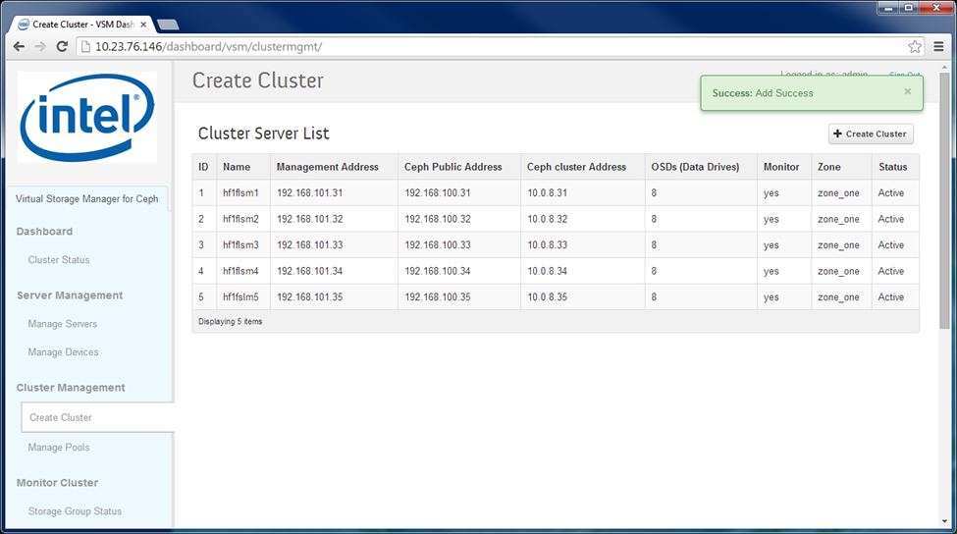
Create Cluster - Status Sequence
Getting Started

Slide 23
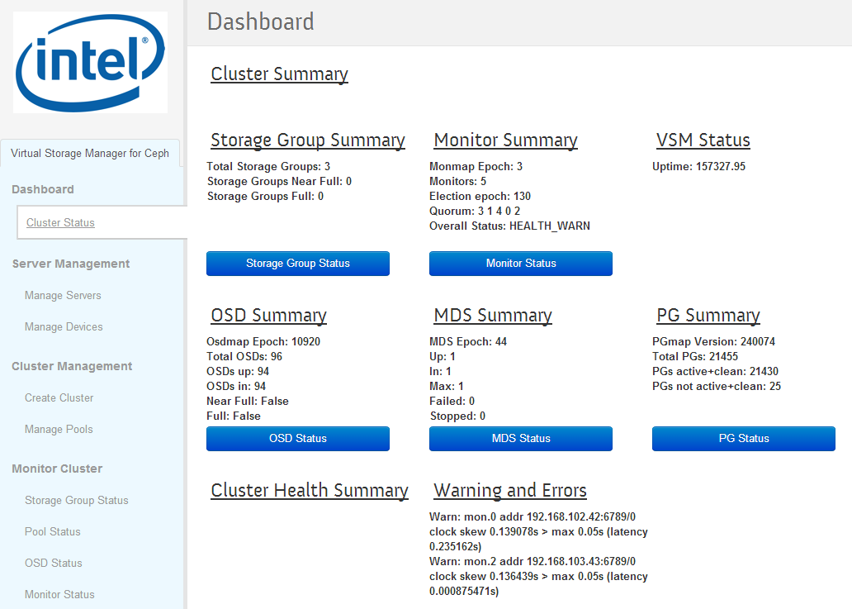
Dashboard Overview
Getting Started
Minimum of three monitors
Odd number of monitors
No warnings
No Storage Groups near full or full
Vast majority of PGs active + clean
Freshly initialized cluster:
94 of 96 OSDs up and in
No OSDs near full or full
Monitor servers not synchronized with NTP server

Slide 24
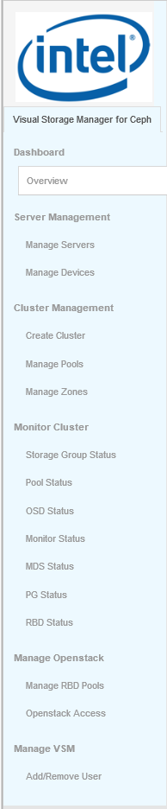
The VSM Navigation Bar
Getting Started
Dashboard – Overview of cluster status
Server Management – Management of cluster hardware – add/remove server, replace storage devices
Cluster Management – Management of cluster resources – cluster and pool creation
Monitoring the cluster – Monitoring overall capacity, pool utilization, status of OSD, Monitor, and MDS processes, Placement Group status, and RBD status
Managing OpenStack Interoperation: Connection to OpenStack Server, and placement of pools in Cinder multi-backend
Manage VSM – Add users, manage user passwords

Slide 25
Managing Capacity

Slide 26
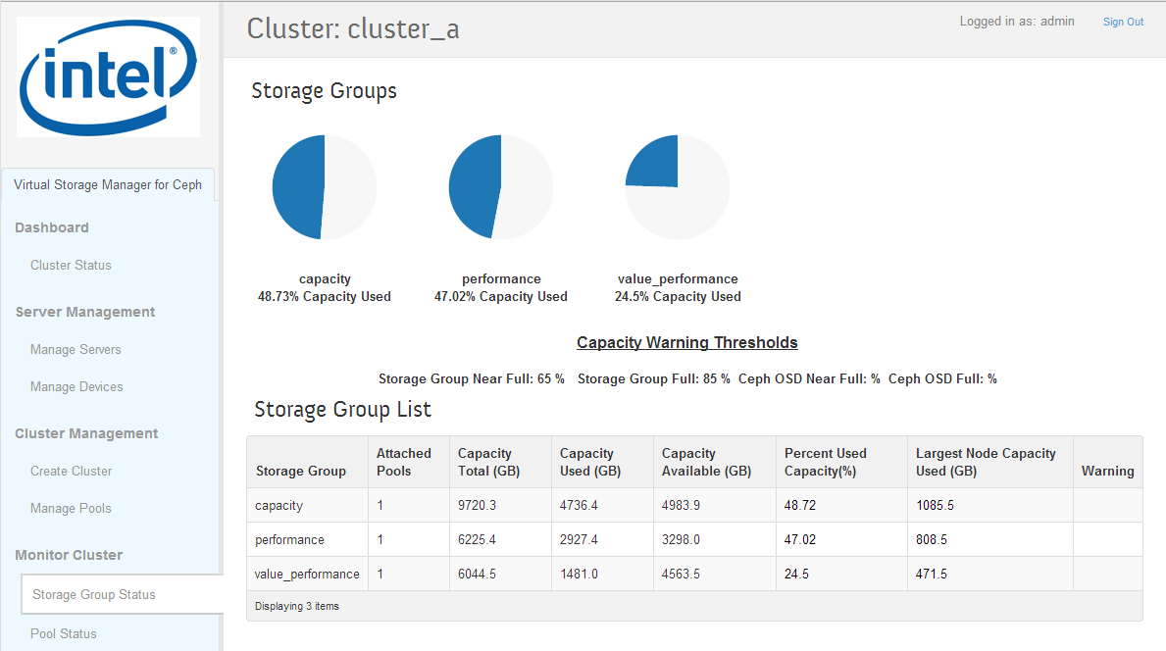
Storage Group Status
Managing Capacity
Storage Group Full and Near Full thresholds
Storage Group Full and Near Full thresholds.
Configurable in cluster manifest
If largest node capacity is bigger than capacity available, then there will be a problem if the largest node fails because there isn’t enough capacity in the rest of the storage group to absorb the loss
Warning message indicates that storage group full or near full threshold is exceeded
Storage Groups
Capacity of all disks in storage group
Capacity that has been used (includes replicas)
Capacity remaining
Used capacity of largest node

Slide 27
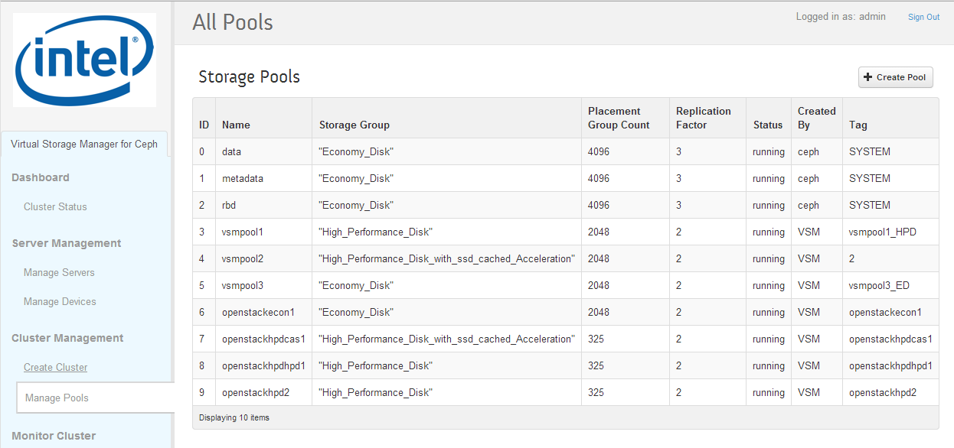
Manage Pools
Optional identifying tag string
Managing Capacity
Where created
(VSM or external to VSM)
Create new pool
Number of copies (primary + replicas)
Pool name
Storage group that Pool is created in
PG Count – automatically set by VSM: (50 * number of OSDs in storage group)/replication factor

Slide 28
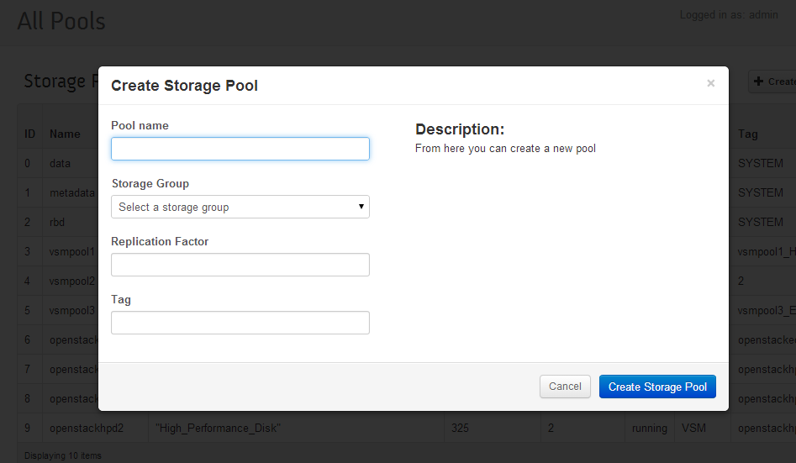
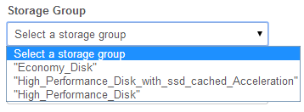
Create Pool
Managing Capacity
Pool Name
Select storage group where pool will be located
Number of copies (primary + replicas)
Optional descriptive tag string

Slide 29
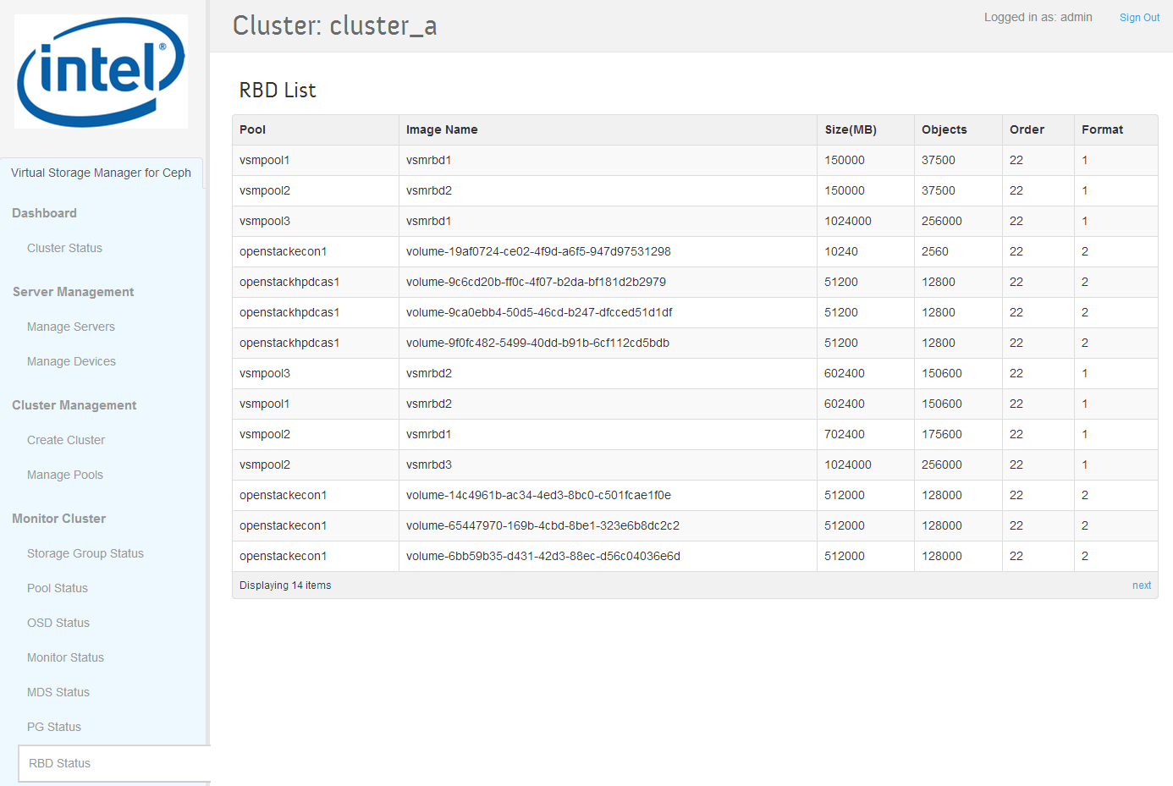
RBD Status
Managing
Capacity
Virtual Disk Size Committed (not used)
Data only (not replicas)

Slide 30
Monitoring Cluster Health

Slide 31
VSM Status Pages: Ceph Data Source Update Frequency
Managing Capacity
Page | Source – Ceph Command | Update Period
Cluster Status | Ceph status –f json pretty | 1 minute
Storage Group Status | ceph pg dump osds -f json-pretty | 10 minutes
Pool Status | osd pool stats –f json-pretty ceph pg dump osds -f json-pretty ceph osd dump -f json-pretty | 1 minute 10 minutes 10 minutes
OSD Status Summary data OSD State CRUSH weight Capacity stats | ceph status –f json pretty ceph osd dump -f json-pretty ceph osd tree –f json-pretty ceph pg dump osds -f json-pretty | 1 minute 10 minutes 10 minutes 10 minutes
Monitor Status | ceph status –f json pretty | 1 minute
PG Status Summary data Table data | ceph status –f json pretty ceph pg dump pgs_brief -f json-pretty | 1 minute 10 minutes
RBD Status | rbd ls -l {pool name} --format json --pretty-format | 30 minutes
MDS Status | ceph mds dump -f json-pretty | 1 minute

Slide 32
Dashboard Overview
Monitoring Cluster Health
Healthy Cluster:
No Storage Groups near full or full
Healthy Cluster: Majority of PGs active + clean
Healthy Cluster:
All OSDs up and in
No OSDs near full or full
See detailed status
Operating cluster may include variety of warning messages
See Diagnostics and Troubleshooting for details

Slide 33
Dashboard Overview
Data Updated Once per Minute
Up to 1 minute delay between page and CLI
Monitoring Cluster Health
Source:
ceph status
-f json pretty
Source: VSM
Source:
ceph health

Slide 34
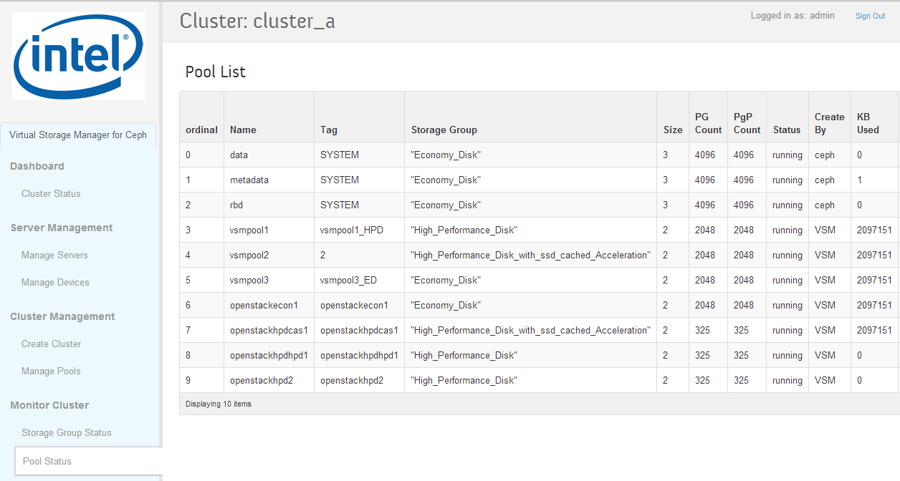
Pool Status
Where created
(VSM or external to VSM)
Monitoring Cluster Health
Number of copies (primary + replicas)
Pool name
Optional identifying tag string
Storage group that Pool is created in
PG Count & PGP Count – automatically set by VSM: (50 * number of OSDs in storage group)/replication factor
Automatically updated when number of disks causes target PG count by more than 2X

Slide 35
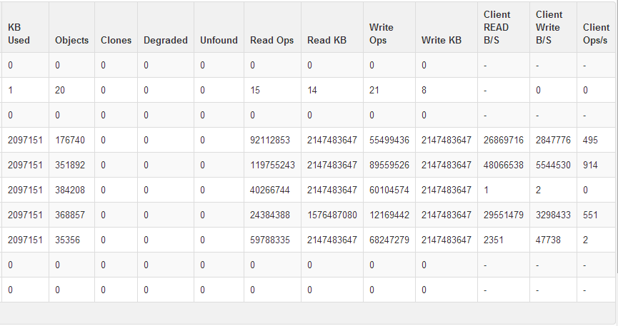
Pool Status
Monitoring Cluster Health
Total read operations
Total read KB
Total write operations
Total write KB
Scroll….
KB used by pool (actual)
Number of objects in pool
Number of cloned objects
Degraded objects – missing replicas
Unfound objects – missing data
Client read bytes / sec
Client write bytes / sec
Client i/o operations / sec

Slide 36
Pool Status
Monitoring Cluster Health
ceph pg dump pools -f json-pretty
ceph osd pool stats -f json-pretty

Slide 37
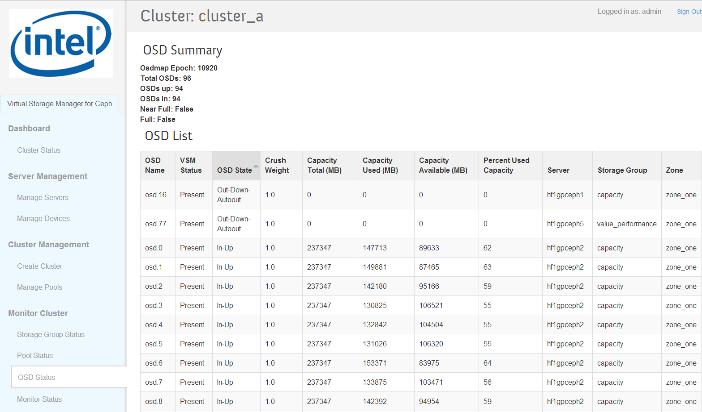
OSD Status
Monitoring Cluster Health
Ceph will automatically place problematic OSDs down and out (autoout)
Sort column to identify auto-out OSDs
Freshly initialized custer:
All OSDs up and in
No OSDs near full or full
Use Manage Devices page to attempt to restart autoout OSDs
Disk Capacity
Used Disk Capacity
Remaining Disk Capacity
Server where OSD disk is located

Slide 38
OSD Status
Monitoring Cluster Health
Sources
OSD State from ceph osd dump -f json-pretty
CRUSH weight from Ceph osd tree –f json-pretty
Total capacity, used capacity, available capacity from ceph pg dump osds -f json-pretty
% Used capacity calculated: available capacity/total capacity
VSM state, server, storage group, zone from VSM

Slide 39
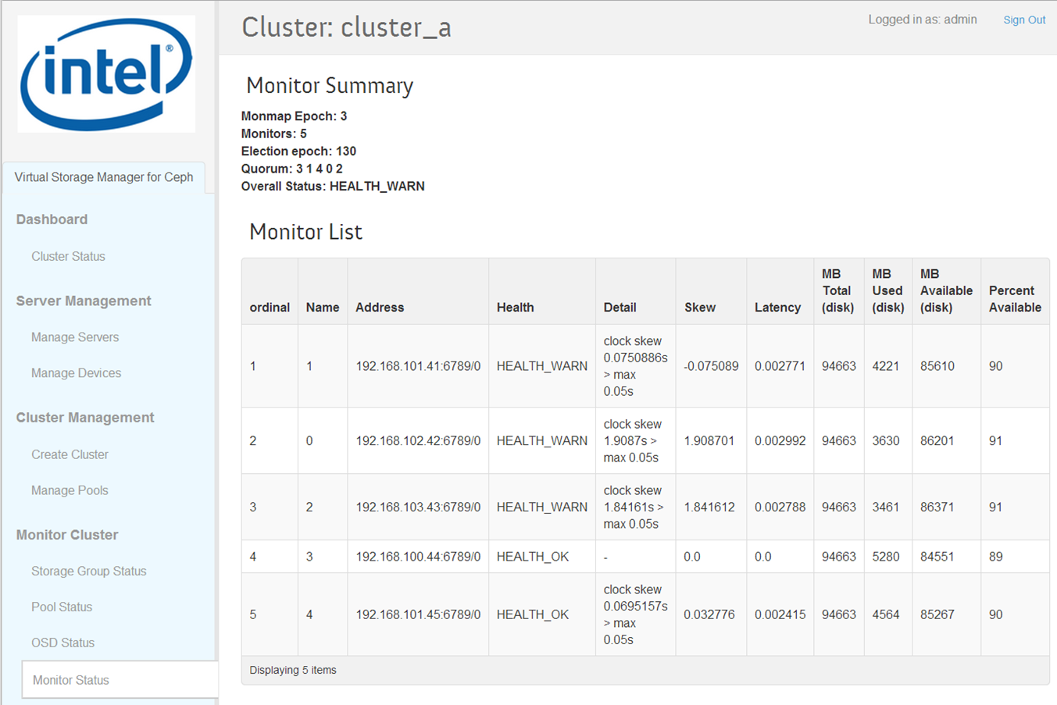
Monitor Status
Monitoring Cluster Health
Source of all ceph data on this page: ceph status –f json

Slide 40
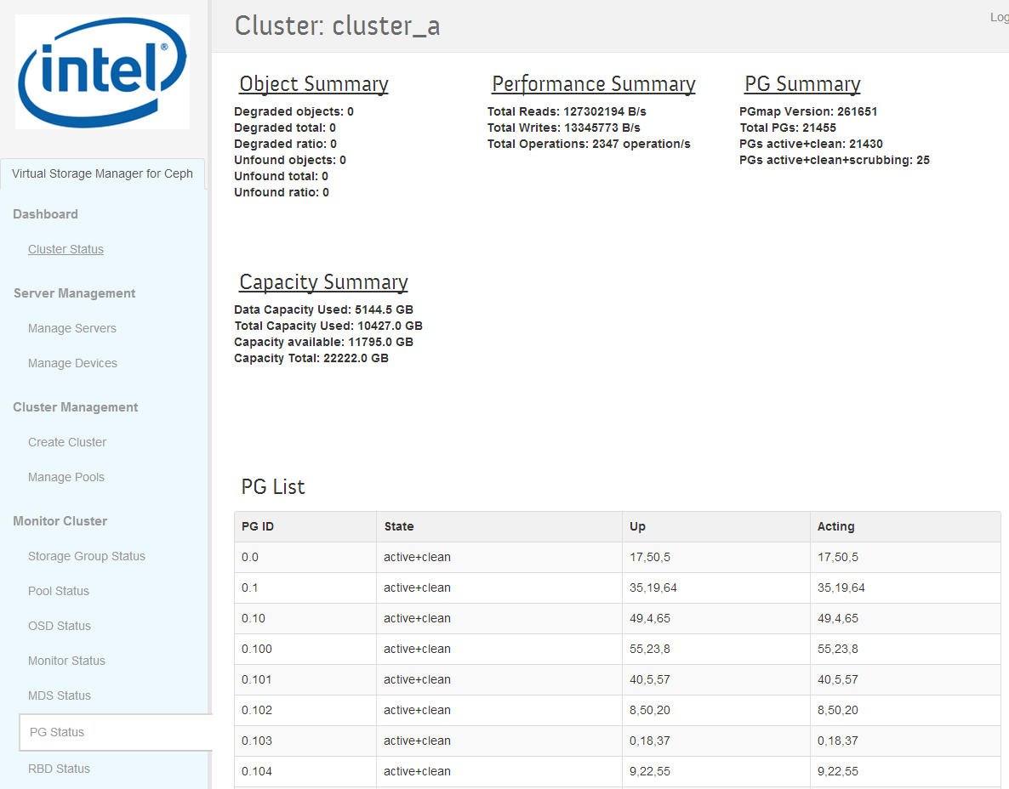
PG Status
Monitoring Cluster Health
Degraded objects – missing replicas
Unfound objects – missing data
Summary of current PG states displayed here
Client data
Client data + replicas
Remaining cluster capacity
Total cluster capacity

Slide 41
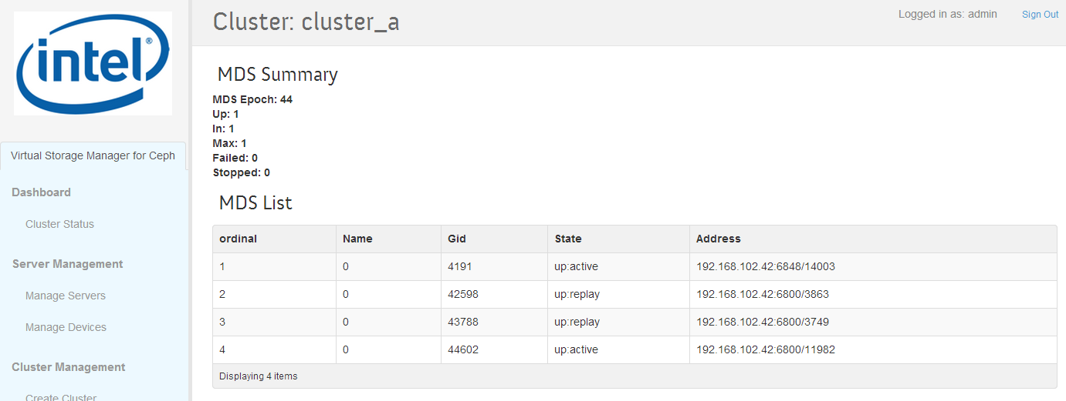
MDS Status
Monitoring Cluster Health

Slide 42
Managing Servers

Slide 43
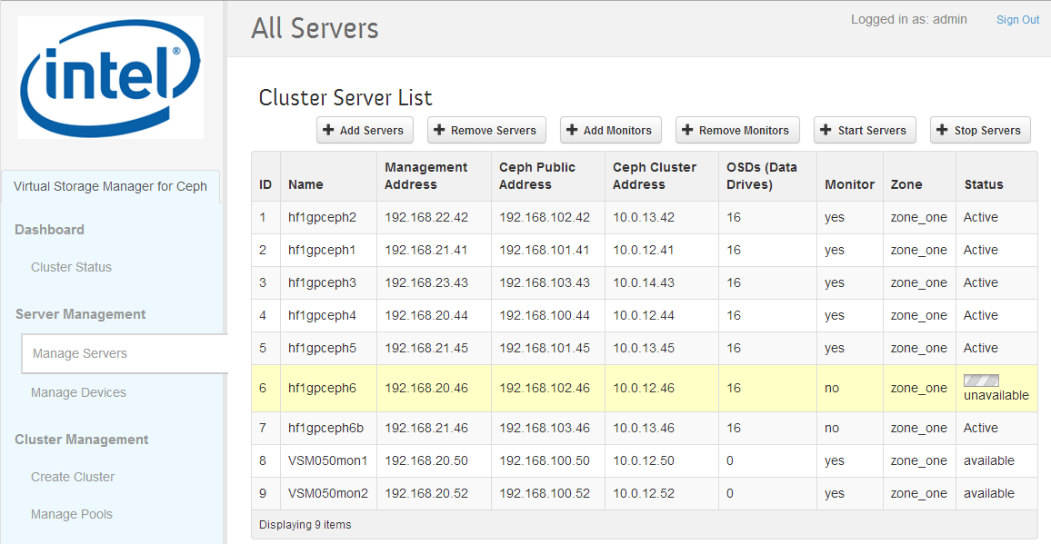
Manage Servers
Managing Servers
Server Operations
Server Status
Management, public (client-side) and cluster-side IP addresses
One Zone with server-level replication
Monitor process running
Disks on server

Slide 44
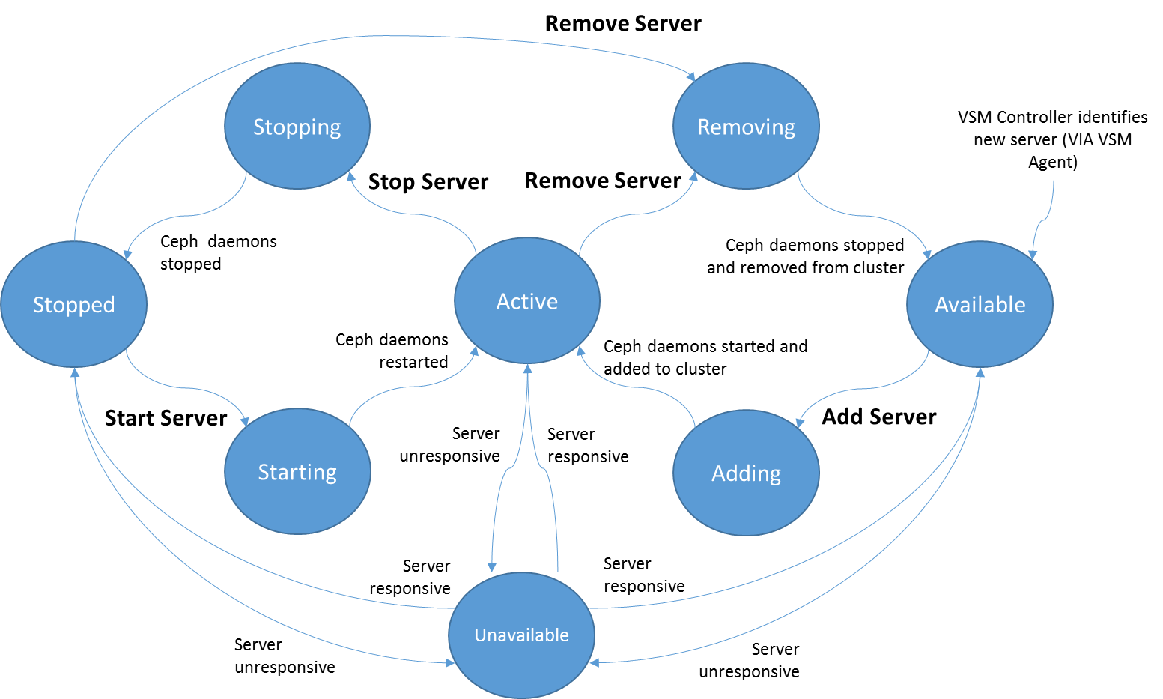
VSM Server State
Managing Servers
Server Operations
Server Operation | Description | Required Server State
Add Server | Selected servers OSDs are added to cluster | Available
Remove Server | Selected servers OSDs are removed from cluster | Active Stopped
Stop Server | Selected servers OSDs are stopped | Active
Start Server | Selected servers OSDs are started | Stopped
Add Monitor | Selected servers monitor daemon is started | Active Available
Remove Monitor | Selected servers monitor daemon is stopped | Active

Slide 45
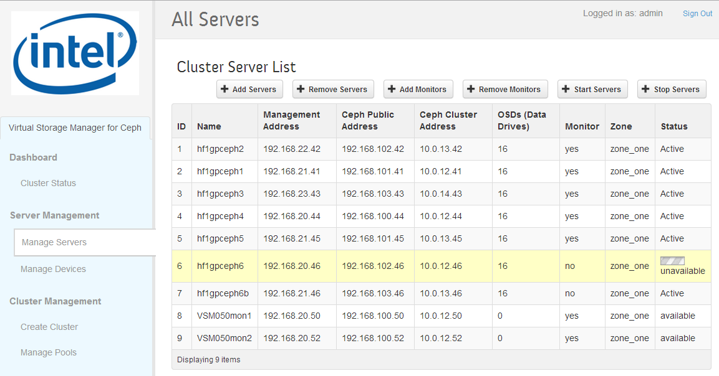
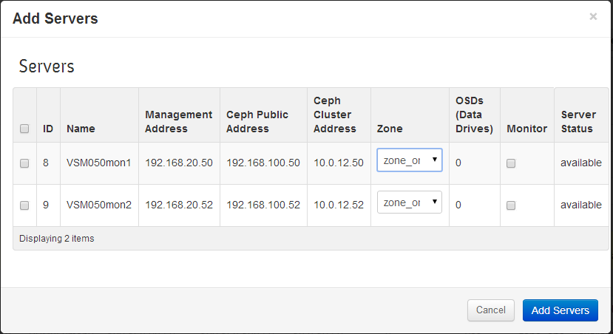
Add Servers
Managing Servers
Add Server
Only valid servers are listed
Select servers to add
Confirm
Set zone (defaults to value in server manifest)
One Zone with server-level replication

Slide 46
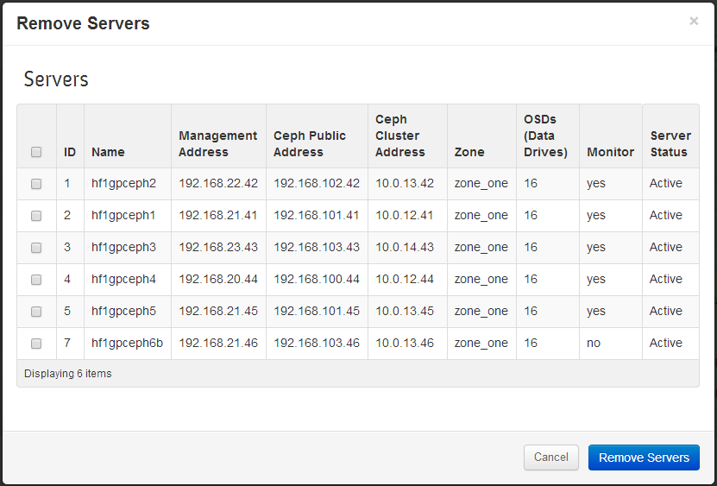
Remove Servers
Managing Servers
Remove Server
Only valid servers are listed
Confirm
Select servers to remove

Slide 47
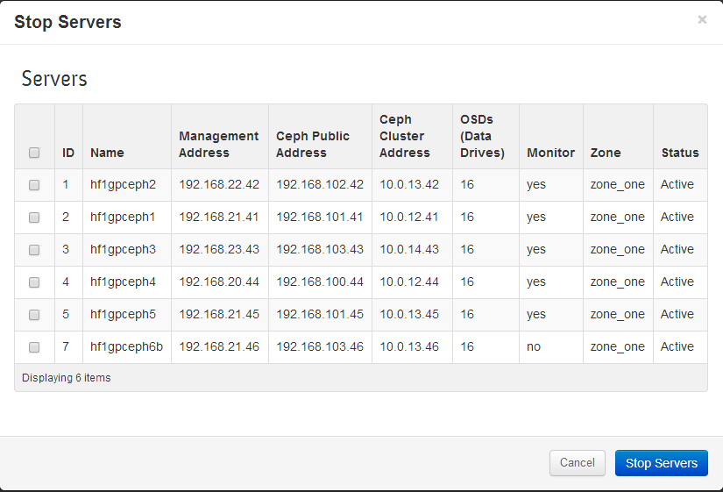
Stop Servers
Managing Servers
Stop Server
Confirm
Select the servers to add
Select server(s)
to stop
Only valid servers are listed

Slide 48
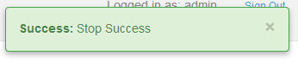
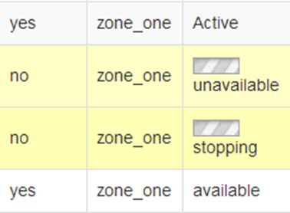
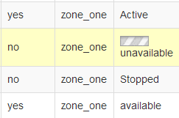
Stop Server - Operation Completion
Managing Servers
Status transitions from Stopping to Stopped
when operation is complete
Starting the operation was successful…….

Slide 49
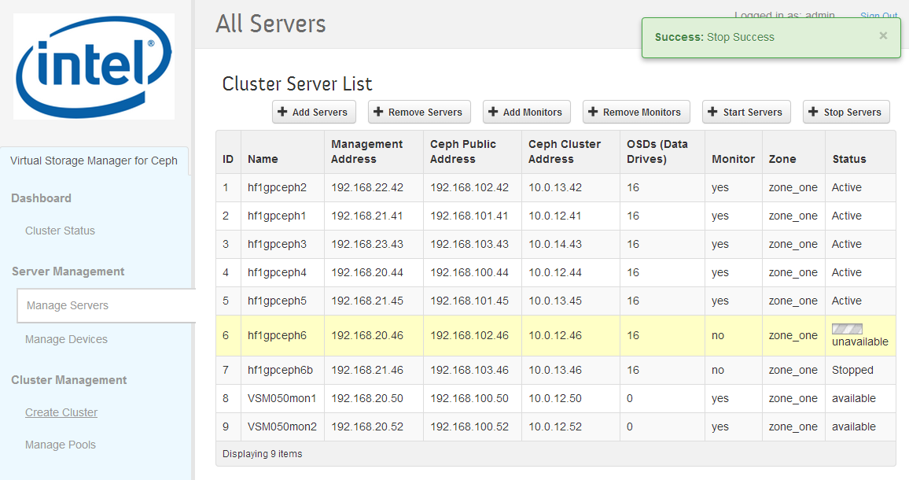
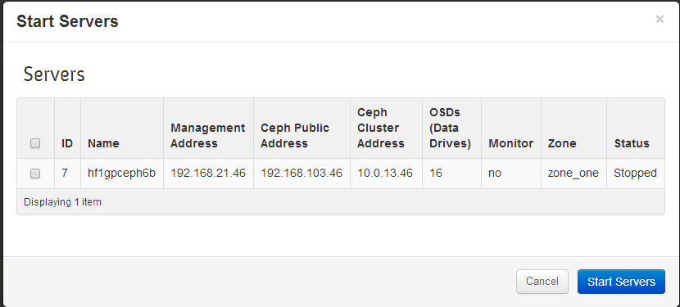
Start Servers
Managing Servers
Start Server
Confirm
Select the servers to start
Only valid servers are listed

Slide 50
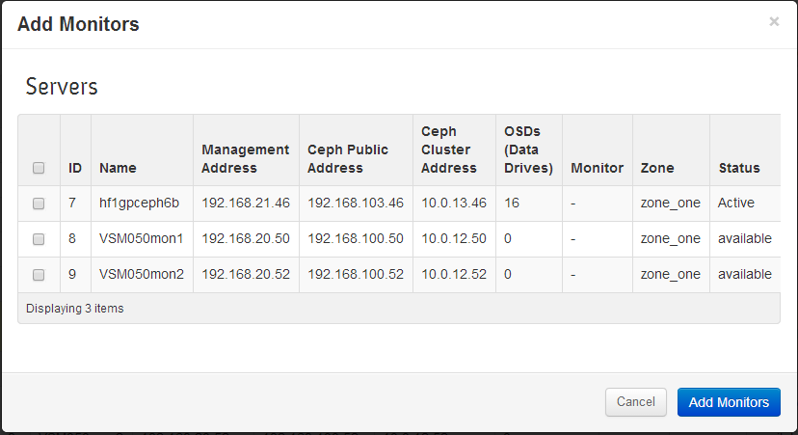
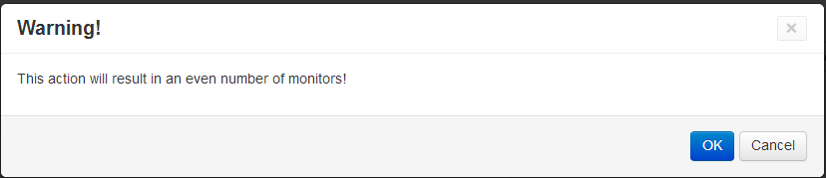
Add Monitor
Managing Servers
Add Monitor
Select servers to start monitors on
Confirm
Warning if resulting number of monitors will be even or less than three
Only valid servers (active/no monitor or available) are listed
Confirm
Again!

Slide 51
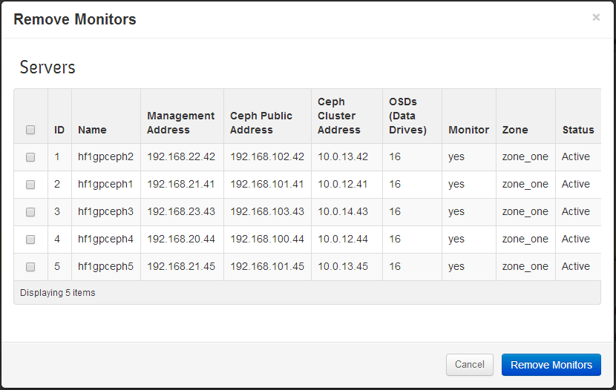
Remove Monitor
Managing Servers
Stop Server
Select servers to stop monitors on
Confirm
Warning if resulting number of monitors will be even or less than three
Only valid servers (active with monitor) are listed
Confirm
Again!

Slide 52
Managing
Storage Devices (Disks)

Slide 53
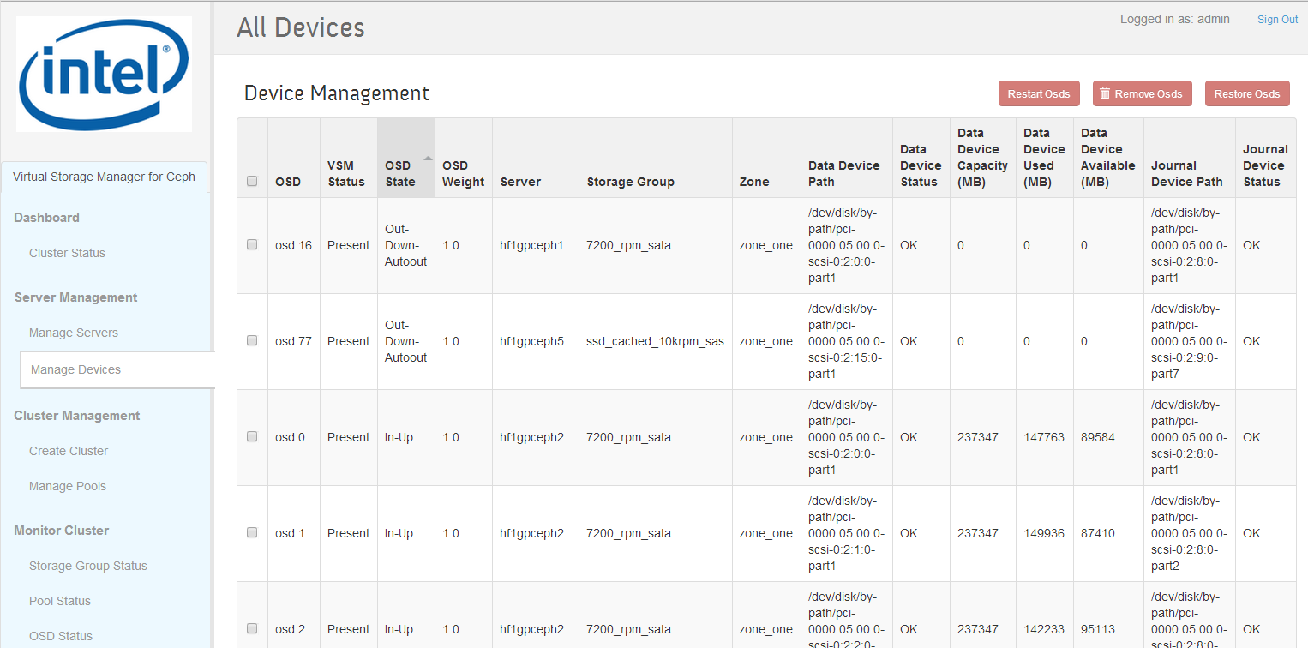
Manage Devices
Restart Autoout OSDs
Remove OSDs
Restore OSDs
Managing Storage Devices
Sort!
Select for operation
Server
Data (OSD) drive path
Drive path check
Capacity utilization
Journal partition path
Drive path check

Slide 54
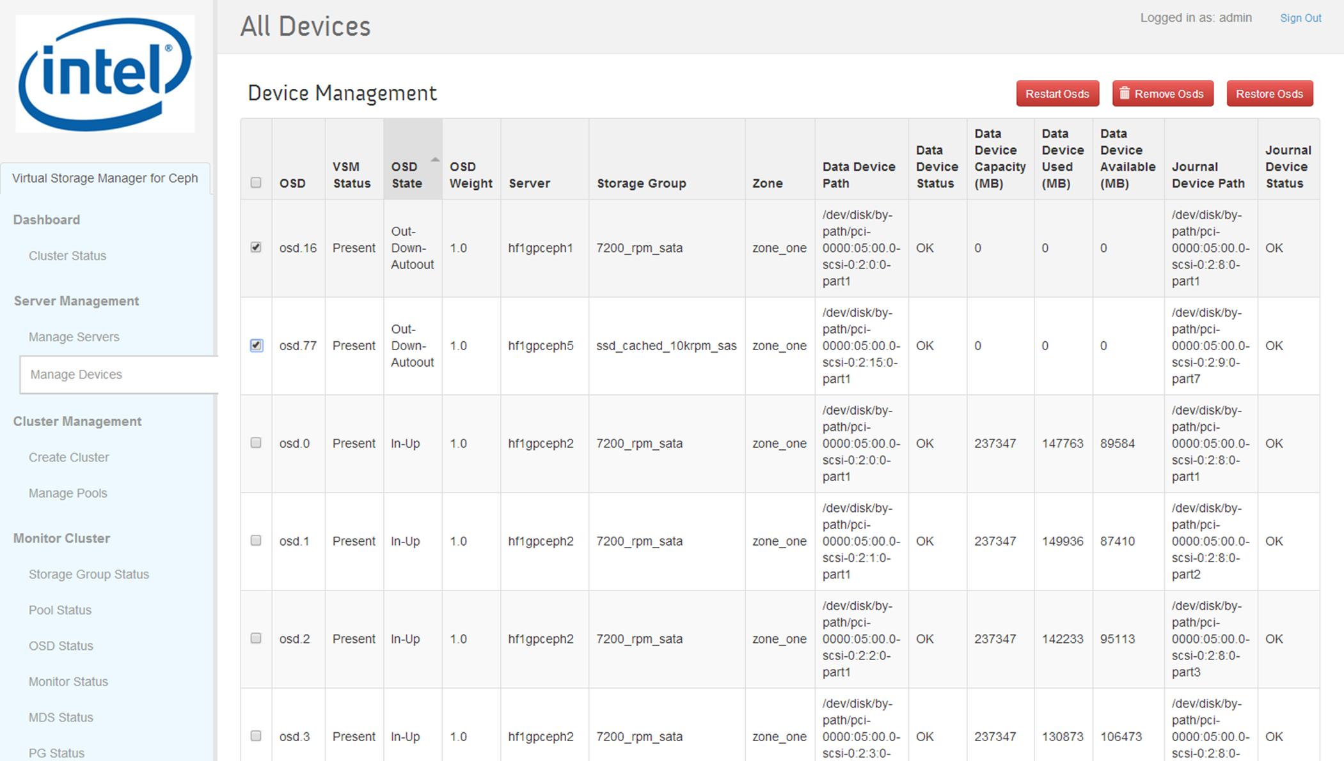
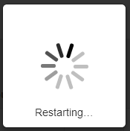
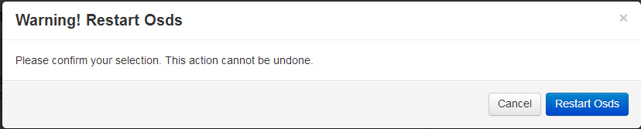
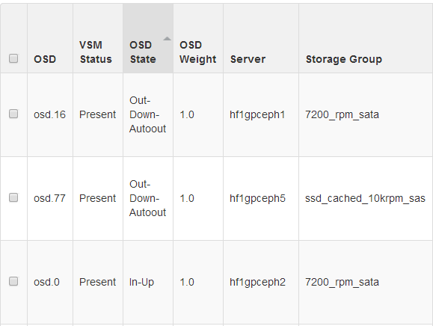
Restart OSDs
Restart Autoout OSDs
Managing Storage Devices
Select
Sort
Wait
Confirm
Verify (may need to sort again)

Slide 55
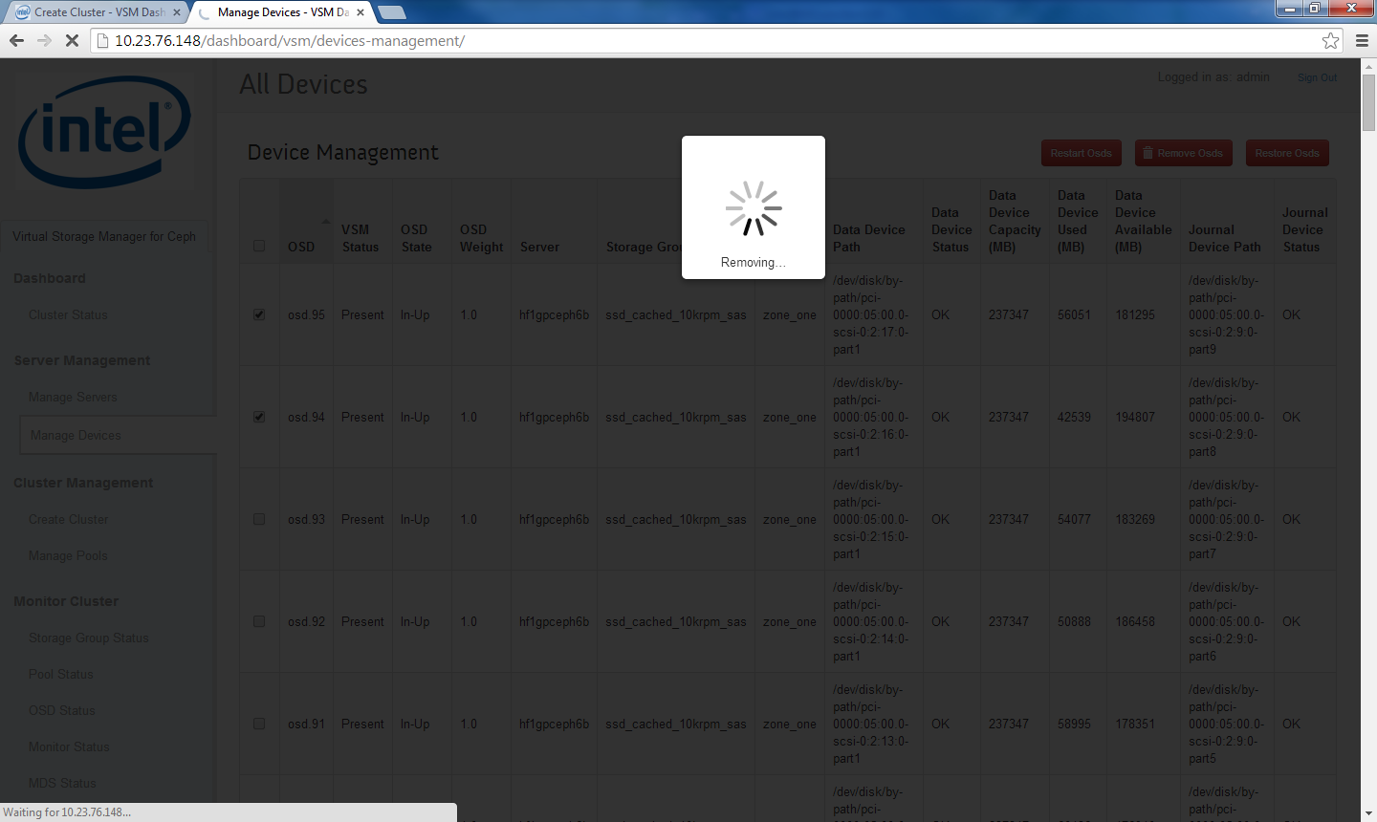
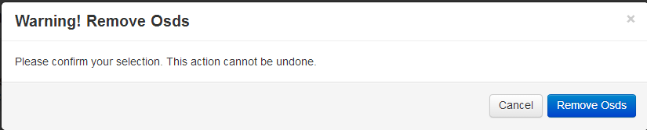
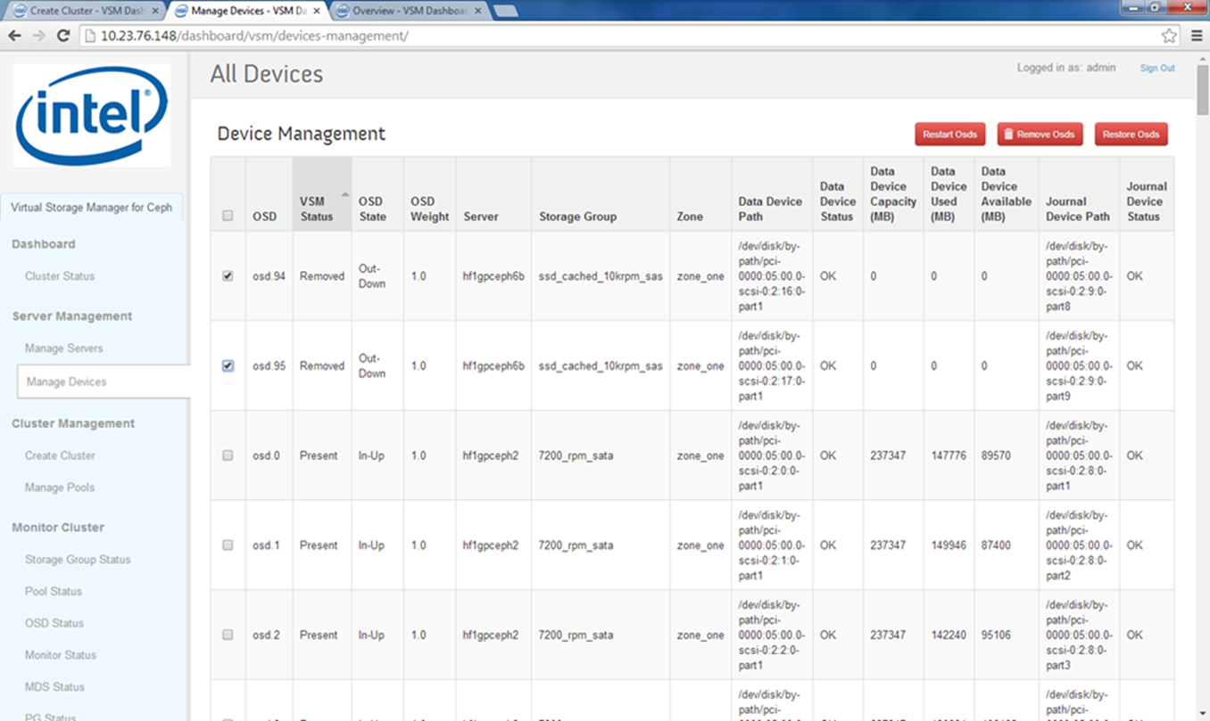
Remove OSDs
Remove OSDs
Managing Storage Devices
Select
Sort
Wait
Confirm
Verify (may need to sort again)

Slide 56


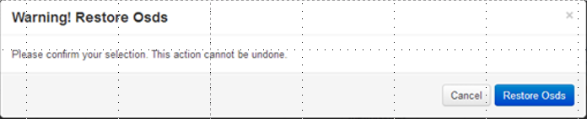
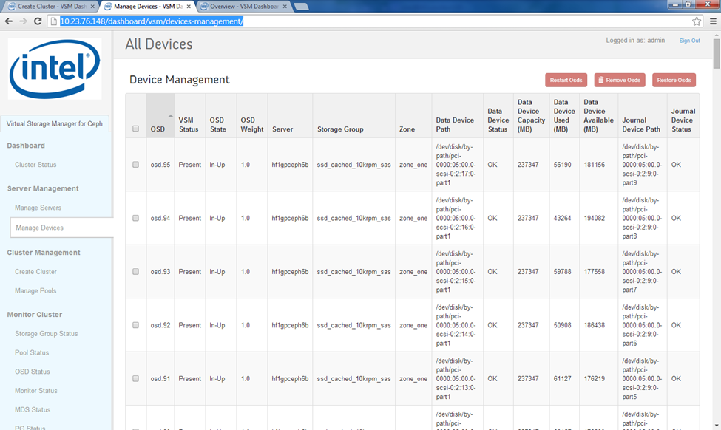
Restore OSDs
Restore OSDs
Managing Storage Devices
Select
Sort
Wait
Confirm
Verify (may need to sort again)

Slide 57
Working with OpenStack

Slide 58


OpenStack Access
Interoperation with OpenStack
Click here to establish connection to OpenStack server
IP address of OpenStack Nova Controller
(Requires established SSH connection)
Confirm

Slide 59


OpenStack Access
Interoperation with OpenStack
Select and Delete to remove connection to OpenStack server
Select and Delete to remove connection to OpenStack server
IP address of OpenStack Nova Controller
(requires established SSH connection)
Edit IP address of OpenStack Nova Controller
(requires established SSH connection)
Confirm

Slide 60

Managing Pools
Interoperation with OpenStack
Attached Status
Created By: VSM or Ceph (outside fo VSM)

Slide 61


Managing Pools
Interoperation with OpenStack
Start Here
Select pools to present to OpenStack
Only valid servers are listed
Confirm

Slide 62
Managing VSM

Slide 63


Manage VSM Users
Managing VSM
Start Here
Password: Must consist of 8 or more characters and include one numeric character, one lower case character, one upper case character, and one punctuation mark
Confirm

Slide 64


Manage VSM Users
Managing VSM
Change Password
Cannot delete default admin user
Delete User

Slide 65
Part 3: Troubleshooting Examples

Slide 66
Troubleshooting Ceph with VSM
Troubleshooting
Stopping servers without rebalancing
OSDs not running
OSDs Near Full or Full
Identifying failed or failing data and journal disks
Replacing failed or failing data and journal disks
Troubleshooting cluster initialization

Slide 67
Stopping without Rebalancing
Troubleshooting
The cluster may periodically require maintenance to resolve a problem that affects a failure domain (i.e. server or zone).
The Stop Server operation on the Manage Servers page allows the OSDs on selected server(s) to be stopped.
When servers are stopped using the Stop Server operation, the cluster is set to “noout” before OSDs are stopped, which prevents rebalancing
Placement groups (PGs) within the OSDs you stop will become degraded while you are addressing issues with within the failure domain.
Because the cluster is not rebalancing, time spent with servers stopped shoud be kept to a minimum
When servers are restarted using the Manage Servers page, “noout” is unset, and balancing resumes
More at: https://ceph.com/docs/master/rados/troubleshooting/troubleshooting-osd/#stopping-w-out-rebalancing

Slide 68


OSDs Not Running
Troubleshooting
The Cluster Status page shows two OSDs not Up and In
Manage Devices page shows two OSDs out-down-autoout state (sort by OSD State)
Manage Devices page shows the server(s) where the out-down OSDs are located
Manage Devices page shows the path where the OSD drives are attached
Relationship between path and physical location
More at: https://ceph.com/docs/master/rados/troubleshooting/troubleshooting-osd/#an-osd-failed

Slide 69

OSDs Near Full or Full
Troubleshooting
The Cluster Status page shows whether any OSDs have exceeded near full or full threshold
Near full, full OSDs identified via cluster health messages
Cluster will stop accepting writes when OSD exceeds full ratio.
Add capacity to restore write functionality
HEALTH_ERR 1 nearfull osds, 1 full osds
osd.2 is near full at 85%
osd.3 is full at 97%
More at: https://ceph.com/docs/master/rados/troubleshooting/troubleshooting-osd/#no-free-drive-space

Slide 70

Using VSM to Ientify Failed or Failing Data and Journal Disks
Troubleshooting
VSM periodically probes drive path – missing drive path indicates complete disk (or controller) failure
VSM periodically probes drive path – missing drive path missing indicates complete disk failure
Repeated auto-out or inability to restart auto-out OSD suggests failed or failing disk
A set of auto-out OSDs that share the same journal SSD suggests failed or failing journal SSD

Slide 71
Using VSM to Replace Failed or Failing Data and Journal Disks
Troubleshooting
Replacing Failed Data Drive
Replacing Failed Journal Disk
On the Manage Device page…
Select the OSD to be replaced
Note the Data Device Path for the device to be removed. Consult your system documentation to determine physical location of the disk
Click on “Remove OSDs”.
Wait until the VSM status for the removed drive is “removed”
On the Manage Servers page…
Click on “Stop Servers”
Select the server where the removed OSD resides
Click on “Stop Servers”
Wait until the stopped server changes to “stopped”
On the stopped server….
Shut down the server (Linux command?)
Replace the failed disk
Restart the server
If needed, configure the drive path to match the data device path as noted in step 1B in the Manage Devices page
This may be required, for example, if the data drive was partitioned
On the Manage Servers page…
Click on “Start Servers”
Select the stopped server
Click on “Start Server”
Wait until the stopped server changes to “Active”
On the Manage Devices page…
Selecte the removed OSD
Click on “Restore OSDs”
VSM status will change to “Present” and OSD State will transition to “In-Up”
On the Manage Device page…
Select all of the OSDs affected by the failed journal drive
Note: This step assumes that one journal drive services multiple OSD drives
Note the Journal Device Paths for each of the affected OSDs. Consult your system documentation to determine physical location of the disk
Click on “Remove OSDs”.
Wait until the VSM status for all selected OSDs is “removed”
On the Manage Servers page…
Click on “Stop Servers”
Select the server where the removed OSDs reside
Click on “Stop Servers”
Wait until the stopped server changes to “stopped”
On the stopped server….
Shut down the server (Linux command?)
Replace the failed journal drive
Restart the server
Partition the new journal drive so as to match the journal device paths of the affected OSDs as noted in step 1B above.
Note: This step assumes that one journal drive services multiple OSD drives
On the Manage Servers page…
click on “Start Servers”
Select the stopped server
Click on “Start Server”
Wait until the stopped server changes to “Active”
On the Manage Devices page…
Selected all of the removed OSD
Click on “Restore OSDs”
For each restored OSD, the operation is complete when VSM status changes to “Present” and OSD State changes to “In-Up”

Slide 72
NTP Server Synchronization
Troubleshooting
Typically due to failure t synchronize servers hosting monitors with NTP service

Slide 73

Troubleshooting freshly initialized cluster I
Troubleshooting
Freshly initialized cluster:
Minimum of three monitors
Odd number of monitors
No warnings
Freshly initialized cluster:
No Storage Groups near full or full
Vast majority of PGs active + clean
Freshly initialized cluster:
158 of 160 OSDs up and in
No OSDs near full or full
PGs associated with down & out OSDs

Slide 74


Troubleshooting freshly initialized cluster II
Two OSDs auto-out
Remapped PGs due to down OSDs
Down and peering OSDs due to down OSDs

